Slide 1
Cool News!

Slide 2
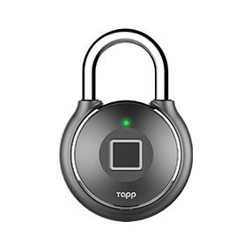
Tapplock
Touch sensor enabled smart lock
Unlockable via app as well as the sensor
$100

Slide 3

Tapplock vs Screwdriver

Slide 4
Tapplock and HTTP vs Basically Any Wireless Device
https://www.pentestpartners.com/security-blog/totally-pwning-the-tapplock-smart-lock/

Slide 5
Every Tapplock in Existance vs Some Dude on His Laptop
https://nakedsecurity.sophos.com/2018/06/18/the-worlds-worst-smart-padlock-its-even-worse-than-we-thought/

